Slide 1


Device Testing
Capstone Design Showcase
April 23, 2025

Slide 2

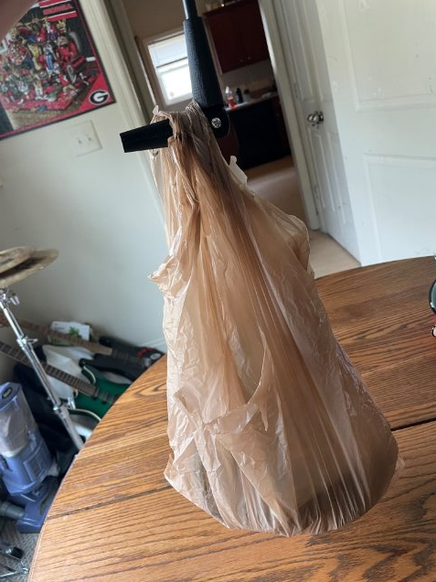
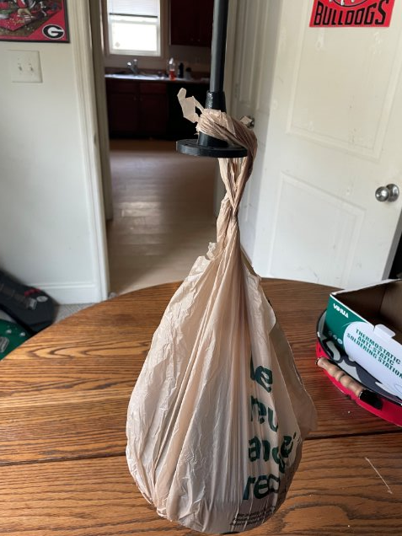

Connection Testing
Test the strength of the connection parts with 2.76 Ibs and 5.52 Ibs weights
Rod Connection Joint Test
Mount Connection Joint Test

Slide 3
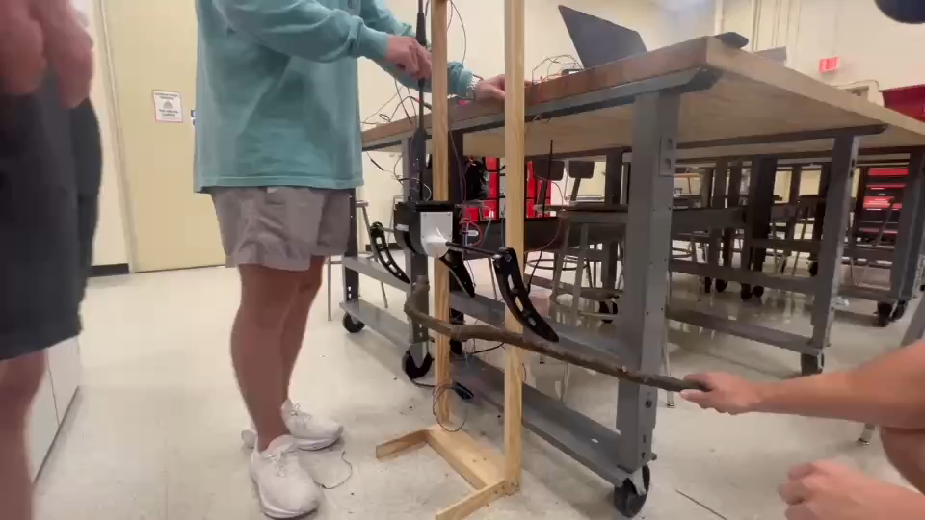
Test Video

Slide 4
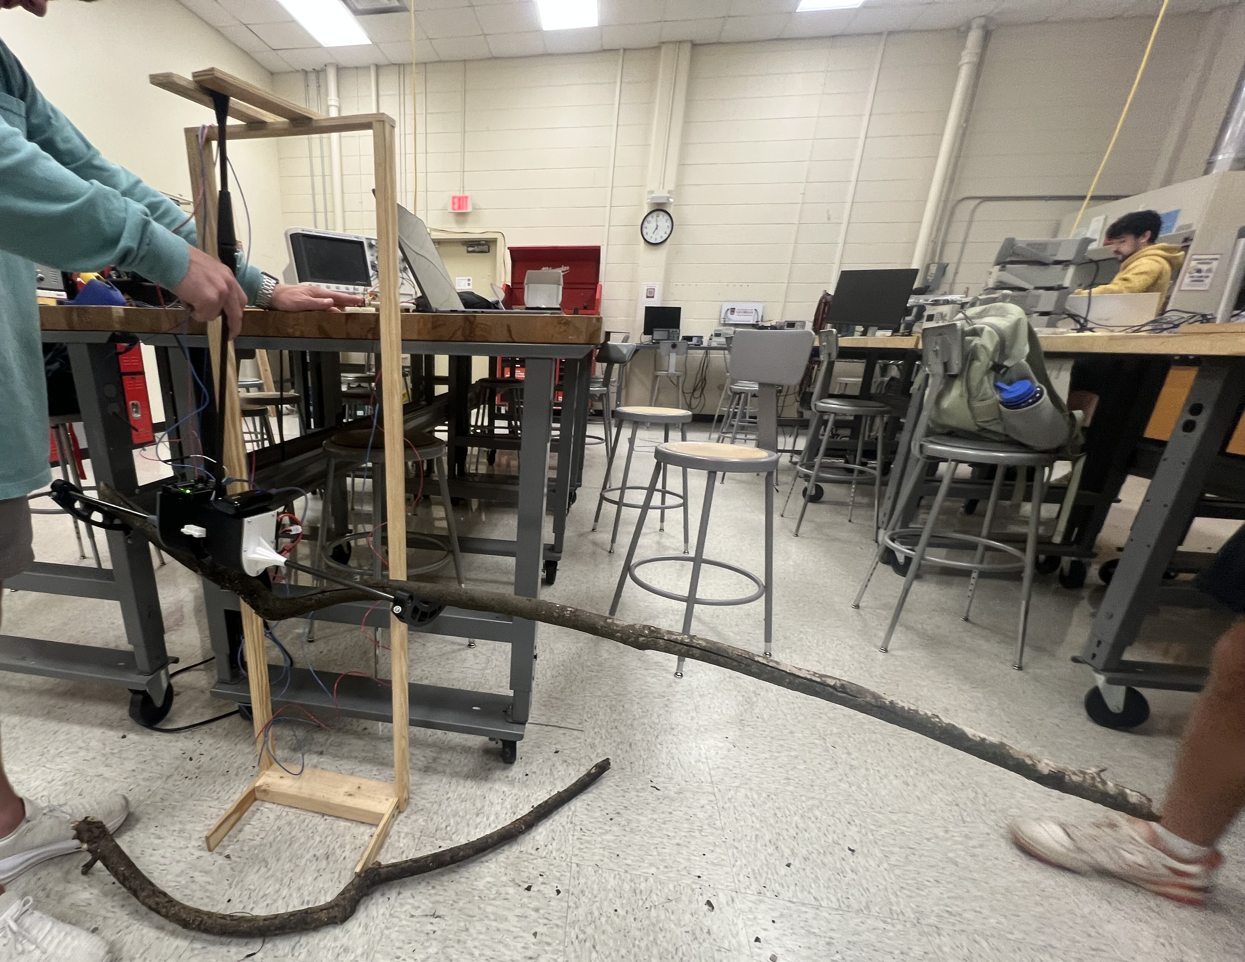
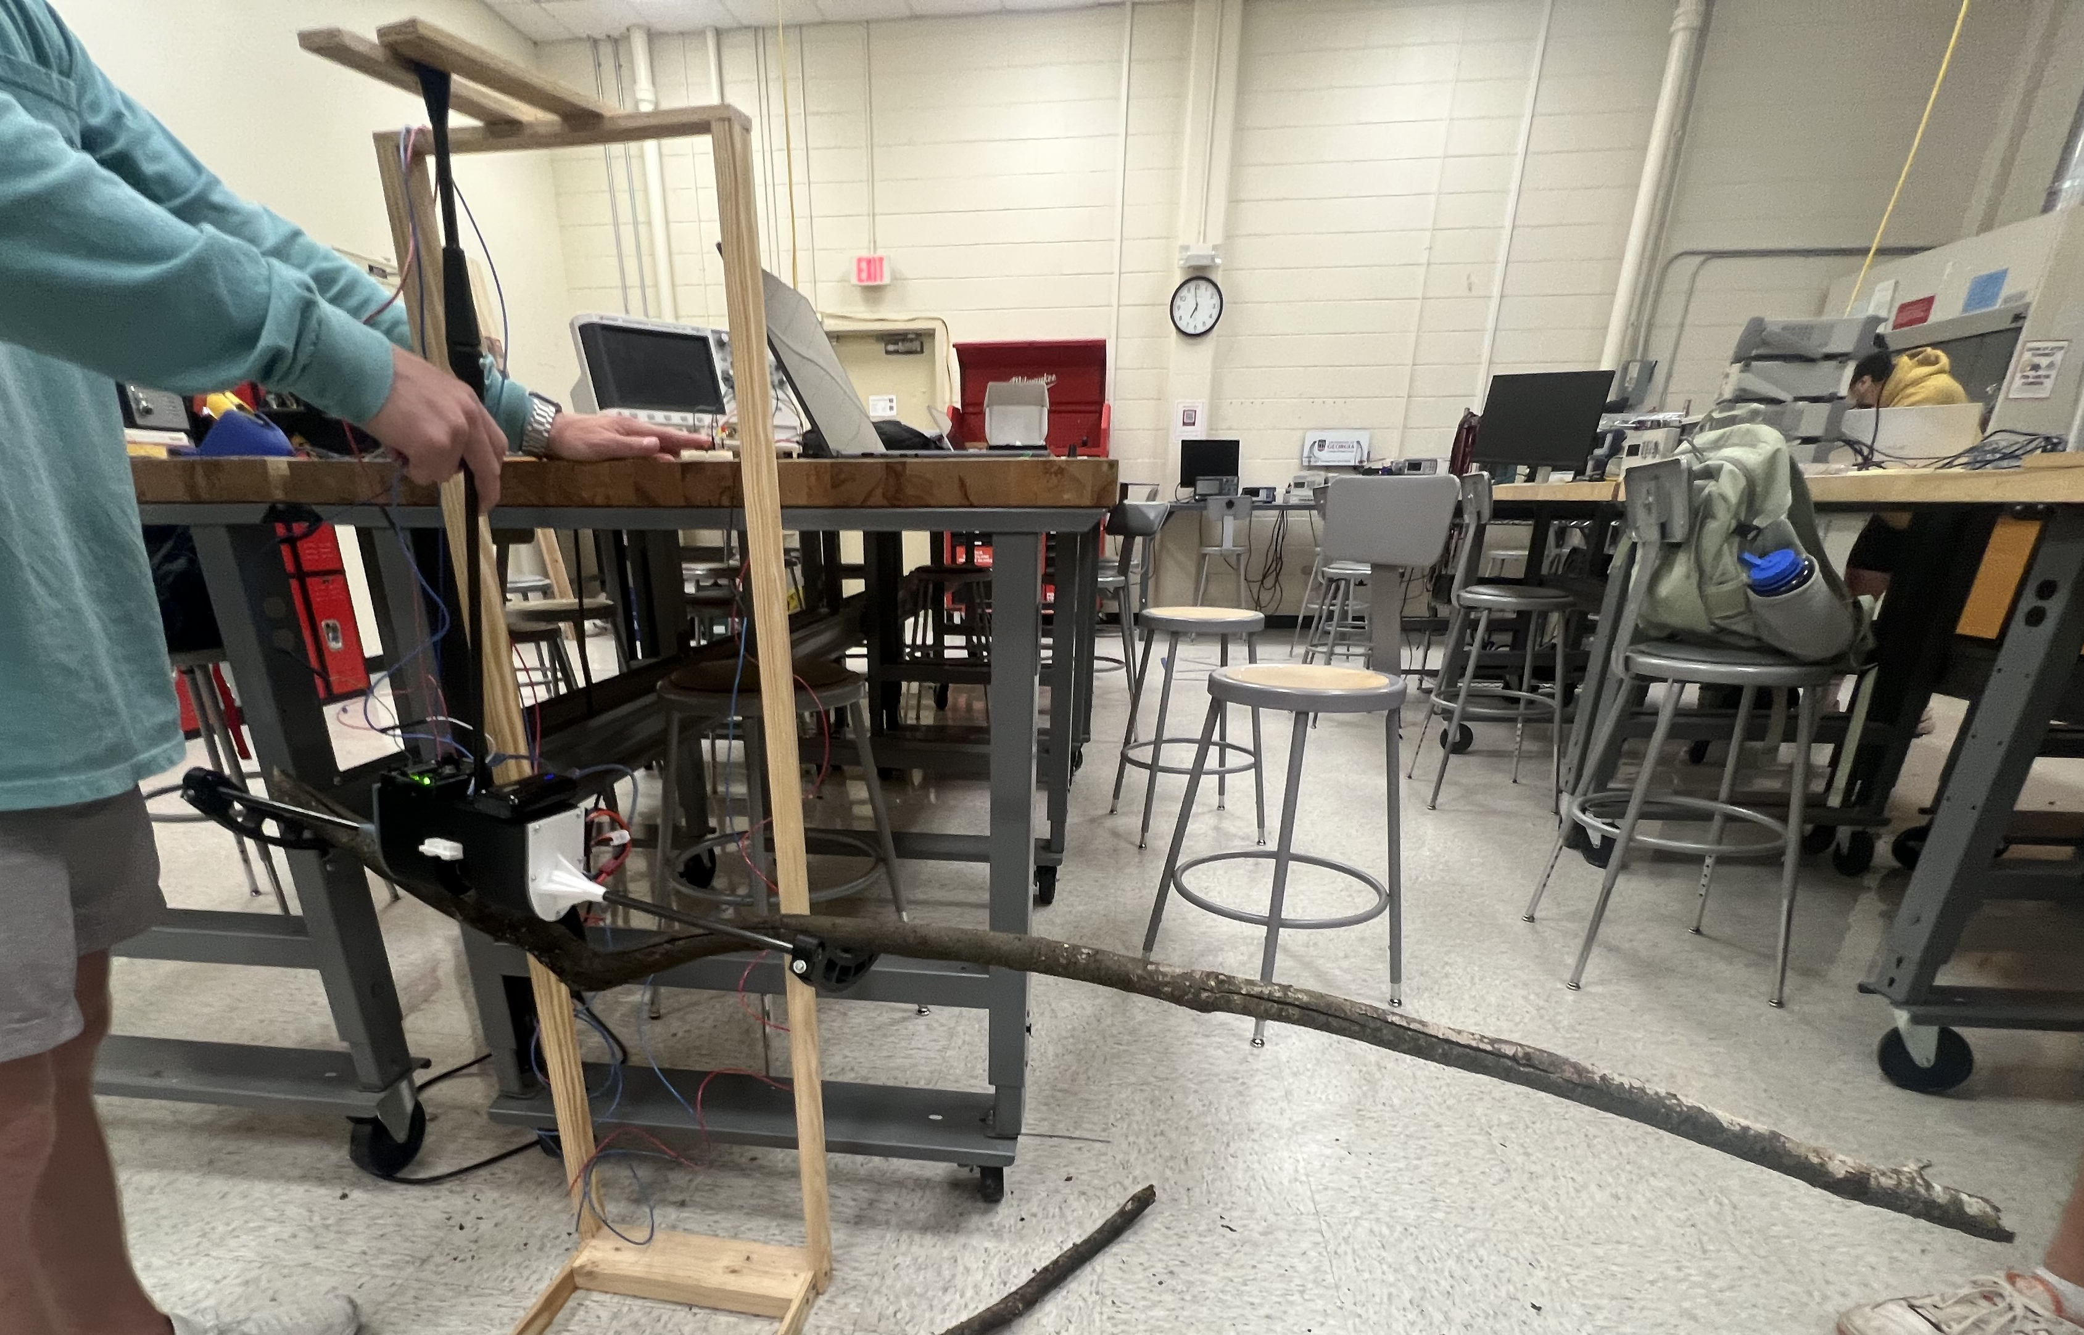
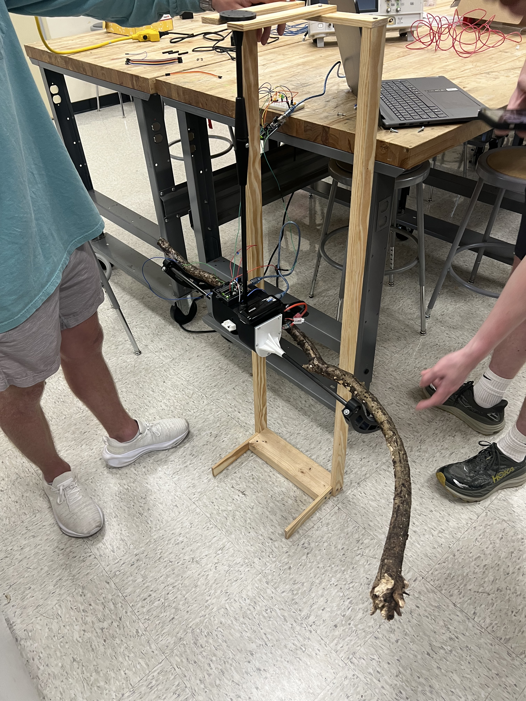

Slide 5
Thank You

